Slide 1
Book1
File created on: 10/14/2024 4:54:11 PM

Slide 2
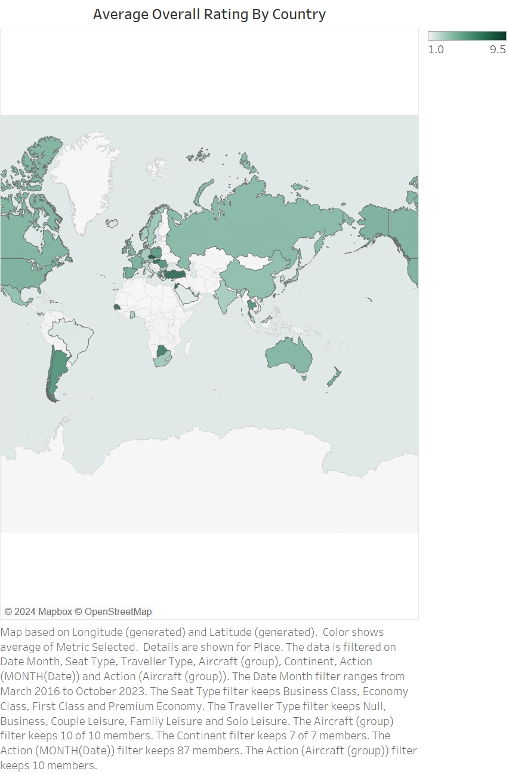

Slide 3


Slide 4
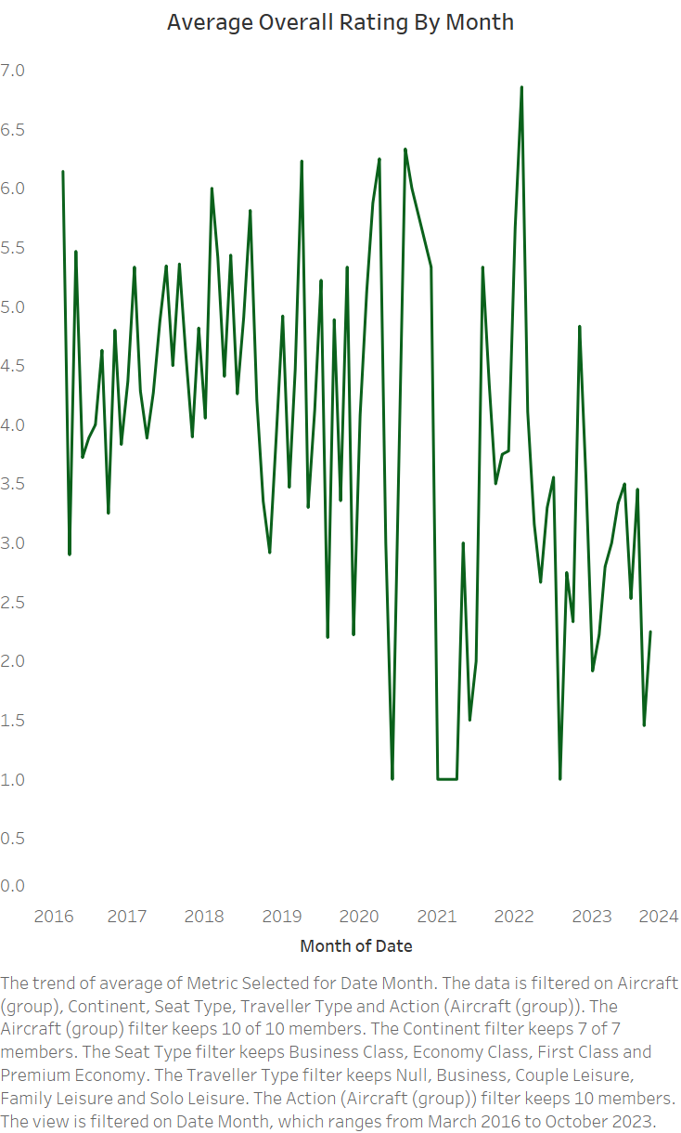

Slide 5
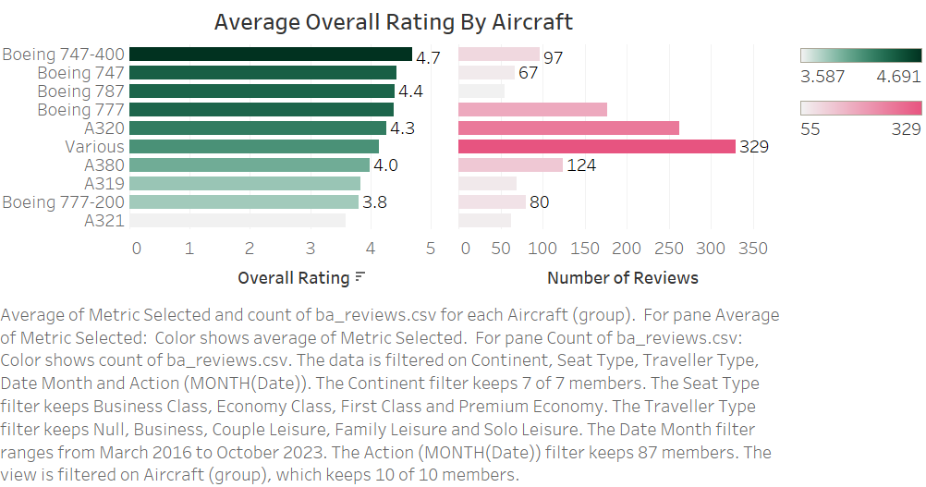

Slide 6
